Slide 1

ET 8304 microprocessor and interfacing
MBEYA UNIVERSITY OF SCIENCE AN TECHNOLOGY
OCTOBER 2022
LECT 3 & 4
INSTRUCTION SET AND EXECUTION IN 8085

Slide 2
Outlines
INSTRUCTION SET 8085
Classification based on functionality
Classification based on instruction length:
Classification based on operand addressing Modes in Instructions
INSTRUCTION EXECUTION AND TIMING DIAGRAM:

Slide 3
Instruction set
An instruction is a binary pattern designed inside a microprocessor to perform a specific function.
Based on the design of the ALU and decoding unit, the microprocessor manufacturer provides instruction set for every microprocessor. The instruction set consists of both machine code and mnemonics.
Microprocessor instructions can be classified based on the parameters such functionality, length and operand addressing.

Slide 4
Classification based on functionality:
Data transfer operations: This group of instructions copies data from source to destination. The content of the source is not altered.
Arithmetic operations: Instructions of this group perform operations like addition, subtraction, increment & decrement. One of the data used in arithmetic operation is stored in accumulator and the result is also stored in accumulator.
Logical operations: Logical operations include AND, OR, EXOR, NOT. The operations like AND, OR and EXOR uses two operands, one is stored in accumulator and other can be any register or memory location. The result is stored in accumulator. NOT operation requires single operand, which is stored in accumulator.

Slide 5
Cont..
Branching operations: Instructions in this group can be used to transfer program sequence from one memory location to another either conditionally or unconditionally.
Machine control operations: Instruction in this group control execution of other instructions and control operations like interrupt, halt etc.

Slide 6
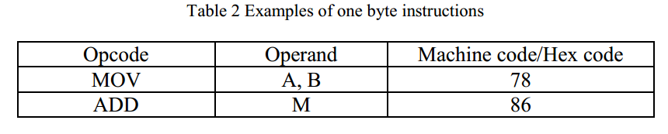
Classification based on instruction length:
One-byte instructions: Instruction having one byte in machine code.

Slide 7
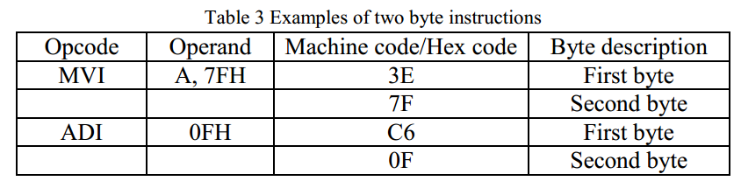
Cont..
Two-byte instructions: Instruction having two byte in machine code.

Slide 8
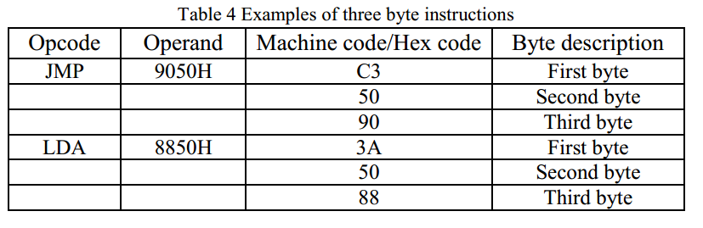
Cont..
Three-byte instructions: Instruction having three byte in machine code.

Slide 9
Classification based on Addressing Modes in Instructions:
The process of specifying the data to be operated on by the instruction is called addressing.
The various formats for specifying operands are called addressing modes. The 8085 has the following five types of addressing:
immediate addressing
Memory direct addressing
Register direct addressing
Indirect addressing
Implicit addressing

Slide 10
Immediate Addressing:
In this mode, the operand given in the instruction - a byte or word – transfers to the destination register or memory location.
Ex: MVI A, 9AH
The operand is a part of the instruction.
The operand is stored in the register mentioned in the instruction.

Slide 11
Memory Direct Addressing:
Memory direct addressing moves a byte or word between a memory location and register. The memory location address is given in the instruction.
Ex: LDA 850FH
This instruction is used to load the content of memory address 850FH in the accumulator.

Slide 12
Register Direct Addressing
Register direct addressing transfer a copy of a byte or word from source register to destination register.
Ex: MOV B, C
It copies the content of register C to register B.
Indirect Addressing:
Indirect addressing transfers a byte or word between a register and a memory location.
Ex: MOV A, M
Here the data is in the memory location pointed to by the contents of HL pair. The data is moved to the accumulator.

Slide 13
Implicit Addressing
In this addressing mode the data itself specifies the data to be operated upon.
Ex: CMA
The instruction complements the content of the accumulator. No specific data or operand is mentioned in the instruction.

Slide 14
5 group of instructions in 8085 up
Data transfer instructions
Arithmetic instructions
Logical instructions
Branching instructions
I/O & machine control instructions

Slide 15
DATA TRANSFER INSTRUCTION
MOV B,C MOV B, M
MVI B, 57 MVI M, 57
LDA 2034 LDA XYZ
LDAX LDAX B
LXI H, 2034
LHLD 2040
STA 4350 STA XYZ
STAX B
XCHG NONE (Hand L with D and E)
PUSH B or PUSH A
POP H or POP A
OUT 87
IN 82

Slide 16
Arithmetic Instructions:
ADD B OR ADD M
ADC B OR ADC M
ADI 45
ACI 45
DAD H
SUB B OR SUB M
SUBB B OR SUBB M
SUI 45
SBI 45
INCR B OR INR M
INX H
DCR B OR DCR M
DCX H
DAA

Slide 17
Logical instructions
ANA R
ANA M
ANI 8BIT DATA
ORA R
ORA M
ORI 8BIT DATA
XRA R
XRA
XRA 8BIT DATA
CMP R
CMP M
CPI 8BIT DATA
CMA
CMC
STC
RLC
RRC

Slide 18
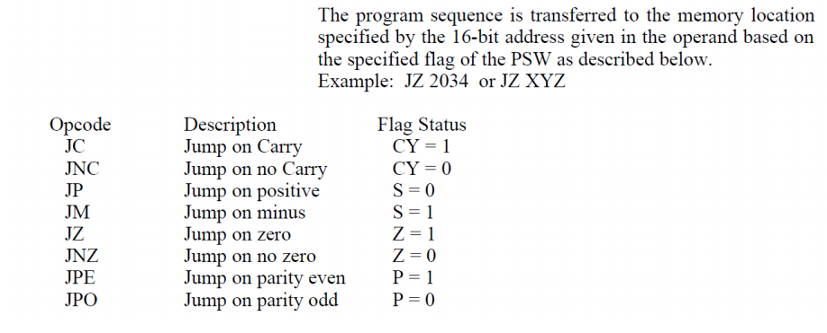
BRANCHING INSTRUCTIONS
JMP 2034
JZ
JC
JP
JPO

Slide 19
I/O and machine control instructions
OUT 50H
IN 80H
NOP
HLT
DI
EI
RIM
SIM

Slide 20
INSTRUCTION EXECUTION AND TIMING DIAGRAM:
Each instruction in 8085 microprocessor consists of two part- operation code (opcode) and operand. The opcode is a command such as ADD and the operand is an object to be operated on, such as a byte or the content of a register.
Instruction Cycle: The time taken by the processor to complete the execution of an instruction. An instruction cycle consists of one to six machine cycles.
Machine Cycle: The time required to complete one operation; accessing either the memory or I/O device. A machine cycle consists of three to six T-states.
T-State: Time corresponding to one clock period. It is the basic unit to calculate execution of instructions or programs in a processor.

Slide 21
To execute a program, 8085 performs various operations as
Opcode fetch
Operand fetch
Memory read/write
I/O read/write
External communication functions are:
Memory read/write
I/O read/write
Interrupt request acknowledge

Slide 22
Assembly language programming for 8085up

